Slide 1
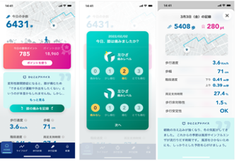
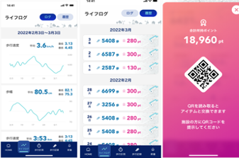
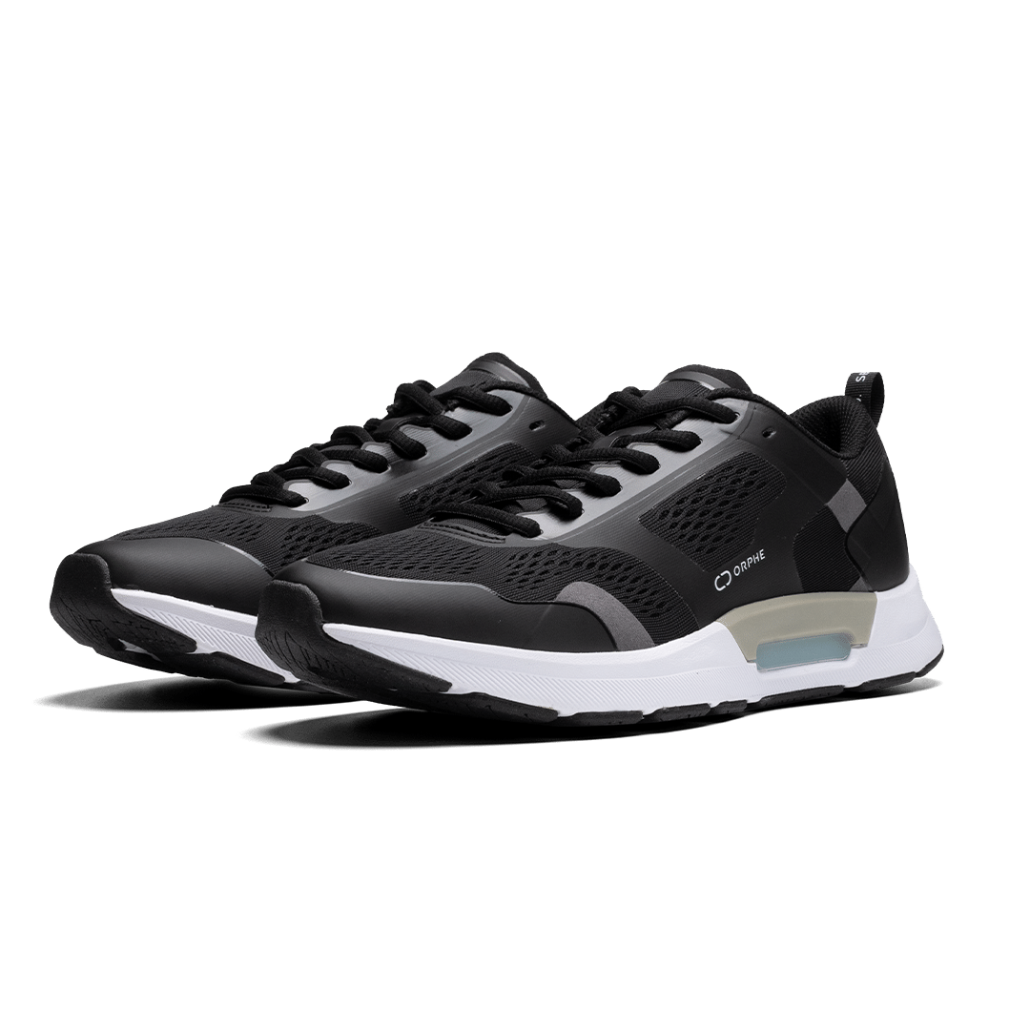
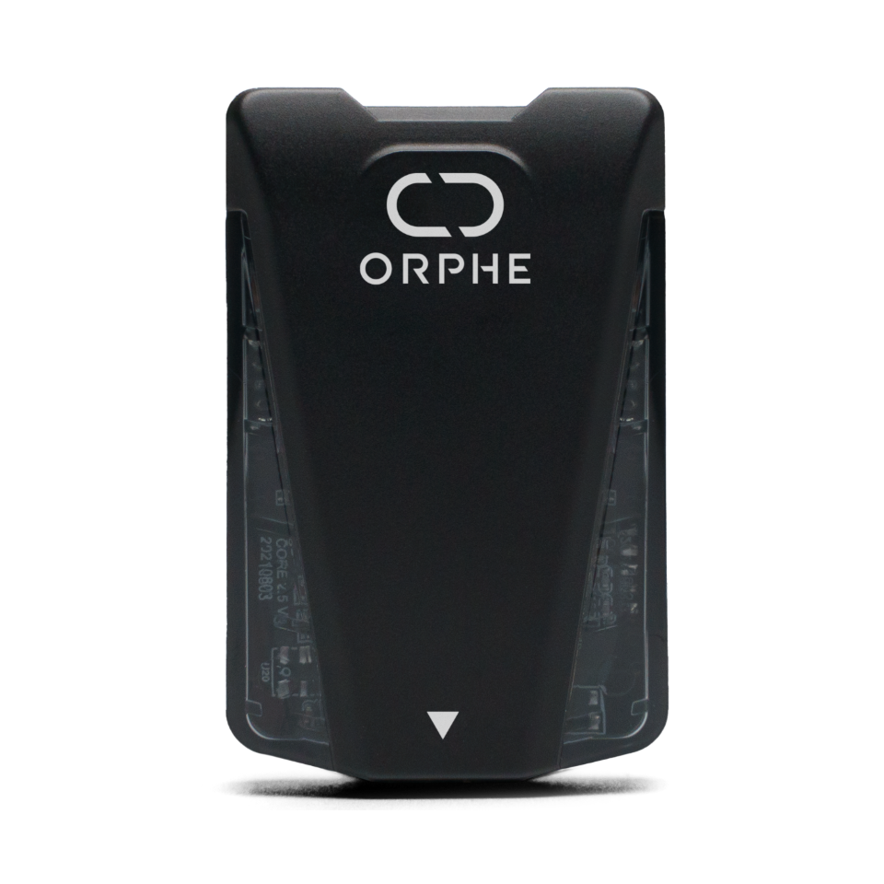



Trustworthy gait data authentication and distribution system connecting doctors, researchers and patients with lower limb musculoskeletal diseases
（ORPHE Inc.）（1/2）
Current issues (Pain points)
What Trusted Web Solves
While the mobile application is assigned a DID,
there is no proof that the sensor data is the patient’s own.
No balance between patients' proactive data control and
an attractive token economy for research/pharmaceutical institutions. (No functionality to return points upon data revoke, etc.)
No incentive design to encourage users to continue to use the application and share data with third parties.
Verify several authentication methods using biometric methods like facial identification or gait identification, and implement an identification system for data itself.
Establish a scalable ecosystem by implementing a point return function and guaranteeing the data integrity required for DCT (Distributed Clinical Trials).
Design incentives to encourage continued use by granting tokens and NFTs that make visible the social contributions of patient users.
Scheme of the Previous Project (As-Is)
Future Scheme (To-Be)
Motivation by
points and NFTs for continued use &
visualization of social contributions
No incentives
for continued use
Mobile app
Patient
Mobile app
Patient
Daily Bio-data Record
Bio-data Sharing to third parties
Gait logs
Points
?
Daily Bio-data Record
Bio-data Sharing to third parties
Advice
Points + NFTs
!
￥
Shoes
Sensors
￥
Shoes
Sensors
Bio-data
Bio-data
Bio-data + Bio-Auth
Bio-data + Bio-Auth
?
?
!
!
No proof of data identification of patient himself/herself
￥
No proof of data identification of patient himself/herself
Trustworthy data authenticated by biometrics
￥
Data request
without
privacy Invasion
Data-based
treatment
Data request
without
privacy Invasion
Data-based
treatment
Trustworthy data authenticated by biometrics
Low availability due to lack of point return functionality and data integrity compliance
High availability due to point returns and data integrity compliance
Research Institutes
/ Pharmaceutical Companies
Medical institutes
Research Institutes
/ Pharmaceutical Companies
Medical institutes
1

Slide 2
Trustworthy gait data authentication and distribution system connecting doctors, researchers and patients with lower limb musculoskeletal diseases
（ORPHE Inc.）（2/2）
Data to be verified
Service user institutions/companies holding proof of contract can issue VC (relationship VC) to their affiliated doctors/researchers, etc. Patients’ data will be shared with the appropriate target through verification of affiliation VC and consent procedure via Woollet.
By using Precise Targeting based on ZKP and patient information VCs, it enables to send data sharing requests to only condition-matched patients without violating patient's privacy.
Legitimacy to be verified | Object of verification | Verification Method | Verifier
Patients want to share certain data with certain target | affiliation VC of data sharing requestor | Verification of affiliation VC and consent procedure for data sharing via Woollet | Patients
Data users want to send data sharing requests to certain patients | Patient Information VC | Sending requests to condition-matched patients using the Precise Targeting | Data sharing requestor (Doctor/Physical Therapists, Researchers, Developers etc.)
Business validation (including UX/UI)
Investigation of specs/technologies to ensure data reliability and implementation of face identification.
Implementation of a point allocation/return system and NFT badges to encourage patients’ activity.
Discussion and improvement of business models for social implementation.
Achievements
System that enables patients to record their own daily data and share the data with doctors and/or researchers.
Biometric authentication using FaceID, and simple account recovery options using biometrics.
Point & NFT badge issuance system contributing to user motivation, point return system for data revoking to maintain the economy.
Understanding of corporate data utilization scenarios (R&D, distributed clinical research), identification of system/device requirements, required data and service fees which can be paid for.
Identification of components required for service implementation through interviews with doctors and patients.

