Slide 1



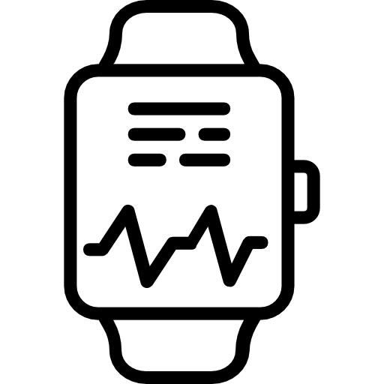
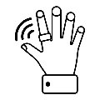

Reliable and applicable information circulation system in clinical trials and healthcare settings
(CMIC Co., Ltd.) (1/2)
Current Issues (Pain Points) (As-Is)
What Trusted Web Will Solve (To-Be)
現在の課題（ペインポイント）
現在の課題（ペインポイント）
Obtaining Personal Identification and Consent (eConsent)
In current online medical consultations and remote participation in clinical trials, eConsent is used to verify the identity of the individual by displaying identification documents such as a driver's license and the person's face on a web screen. However, it is difficult to argue that this method is appropriate.
In face-to-face environments, as opposed to remote environments mentioned above, verification of the individual and obtaining consent for various scenarios such as medical treatment, hospitalization, surgery, and participation in clinical trials are done through signatures on paper documents. However, due to the nature of paper media, seamless integration and coordination with other actions are not possible.
Utilizing PHR (wearable devices, etc.)
In general medical care and clinical trials (DCTs), there are difficulties in utilizing data from patients (subjects) on wearable devices. One of the reasons for this is the lack of a trusted environment and control mechanism on existing networks and devices, where patients give consent on the range of data and who to provide it to.
Regarding the above, implementing individual technologies for each wearable device would increase operational costs and impose burdens on users (patients, subjects, and on-site staff) understanding, making it impractical.
From the perspective of data integrity, since the wearable device is a source of data, it is necessary to consider security, personal authentication, and other factors with the wearable device as a starting point. However, there is insufficient technical verification and investigation regarding the practicality of utilizing these aspects in real clinical settings and clinical trials.
Obtaining Personal Identification and Consent (eConsent)
Creating personas, implementing DID, and using pairing to build a trust relationship with hospital staff (as well as pharmaceutical company/CRO staff) through smartphone applications.
The process of identity verification and consent acquisition is considered complete after pairing with hospital staff (as well as pharmaceutical company/CRO staff) is performed. This is achieved by displaying an eDocument on the medical institution's device, which includes an eSignature linked to personal information through a DID, thereby making the consent acquisition process visible (= eConsent).
Utilizing PHR (wearable devices, etc.)
During the pairing process (step 1), using DID mapping, multiple wearable devices that are identified as being owned by the same entity are seamlessly paired with the smartphone, which serves as a hub and implements a DID. After pairing, each wearable device can share data within the scope of the consent given in step 1 (data is encrypted and can only be accessed by paired users). Additional coding is done to specify the range of data sharing and provide consent control, in accordance with general medical care or the clinical trial protocol.
On the smartphone application from step 1, it is also possible to revoke consent (terminate the pairing), and data sharing is halted after consent revocation.
The above steps 1 and 2 are seamlessly implemented, using the initial pairing as the touchpoint.
Scheme diagram before problem-solving (As-Is)
Business scheme diagram of the generated use case (To-Be)
(in the case of clinical trials, etc.)
Hospital Staff
Patient/Subject
Pharmacist/
CRO Staff
<Issue>
Methods for verifying personal identity and expressing consent
Individual device management
Patient/Subject
Explanation and acquisition of consent, and Pairing
Pairing
Storage of signed and encrypted data within the scope of consent
Storage of signed and encrypted data within the scope of consent
<Issue>
Lack of integration between consent acquisition and data acquisition control
Individual device management
Ensuring authenticity of multiple device data while considering data integrity
Viewing and receiving data after decryption
Viewing and receiving data after decryption
Service usage fees (system and consulting)
Service provision
Service provision
Service provision
Hospital Staff
Pharmacist/
CRO Staff
System provider

Slide 2
Reliable and applicable information circulation system in clinical trials and healthcare settings
(CMIC Co., Ltd.) (2/2)hfc
Data to be Verified
Issues to be Verified | Object of Verification | Verification Method | Verifier
Seamless management from consent acquisition to utilization of wearable devices, data sharing, and integrated control | Process of obtaining consent for participation in clinical trials, etc., and recording of signatures | Signature verification | Patient/subject Hospital staff Pharmacist/CRO staff
Seamless management from consent acquisition to utilization of wearable devices, data sharing, and integrated control | Data provided from wearable devices | Signature verification | Patient/subject Hospital staff Pharmacist/CRO staff
Consensus Building and Trace
By using patient expression of consent for data sharing with third parties, such as physicians, as a touchpoint, a trust relationship (pairing) is established. This is seamlessly achieved through DID mapping implemented on edge devices, allowing data from multiple devices to be shared within the scope of consent. The duration and scope of data sharing are controlled by the data subject, and only stakeholders who have established a trust relationship can perform signature verification on the data.
Business Validation (including UX/UI)
Development of Governance and Community Activities
We conducted research on wearable devices compatible with the prototype system of this project and carried out the definition of wearable device requirements taking into account data integrity considerations.
We organized the governance, rules, business feasibility, and the necessity of data standardization for the utilization of wearable devices such as PHRs in daily medical care and clinical trials through interviews with device manufacturers, pharmaceutical companies, medical institutions, and the PHR service industry association.
We conducted implementation tests using the prototype system of this project and conducted research on UI/UX.
Main
Achievements
Based on the definition of wearable device requirements, we conducted market research and created an output called "Wearable Device List" as the result. Primarily, wearable devices that fall into the following patterns have been introduced to the market, and this project is capable of accommodating each of them.
Devices that consider data integrity as much as possible, which can implement DID (Decentralized Identifier) on the device itself.
Devices that can retrieve data from cloud servers or other sources through APIs (encryption possible using the DID of a smartphone, for example).
Based on the results of the validation tests and stakeholder interviews, the following achievements have been confirmed:
Based on the clinical trials of DCT (Decentralized Clinical Trial) packages, there is a significant demand for wearable devices in the future. They can potentially address existing challenges such as building trust relationships during data provision and operational costs.
They provide a user interface and user experience (UI/UX) that is tailored to the clinical trial setting, offering easier usability compared to existing systems and ensuring a certain level of usefulness.
The user interface and user experience (UI/UX) also offer usefulness for those such as elderly users.
However, there are several challenges that need to be addressed. These include the stakeholders' understanding of the Trusted Web concept, accuracy management and standardization of wearable devices, data format standardization, and the need for guidance and guidelines. It is essential for the industry as a whole to work on understanding the concept of Trusted Web, ensuring data quality and standards, and establishing operational and monitoring systems.

