Slide 1

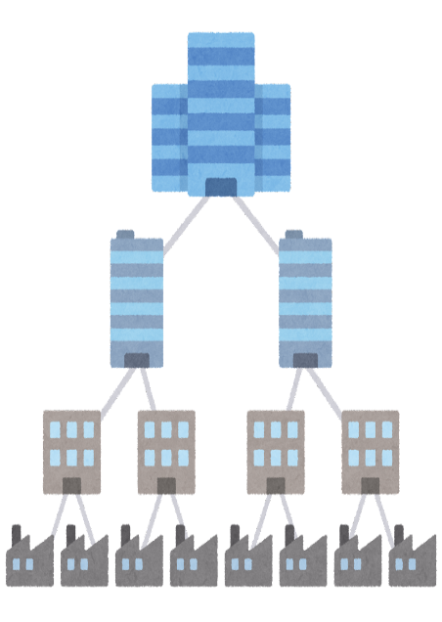








Business Unit Identity and its Digital Certification Infrastructure (SBI Holdings, Inc.) (1/2)
Current Issues (Pain Points)
What Business Unit Identity Will Solve
Fragmented supply chain data (non-standardized, redundant and inefficient)
Data reliability in the supply chain cannot be guaranteed (risk of erroneous or forged information)
The entire supply chain, including SMEs, is not connected (SMEs are left out of the information network)
Identification and authentication of business units participating in the supply chain will enable an interconnected and trustworthy supply chain network.
Interconnected with multiple industry and business group networks, as well as the establishment of mutual recognition standards, will enable trustworthy cross-border supply chain networks.
Current Situation (As-Is)
Business Scheme Diagram (To-Be)
Data fragmentation
Delay in connection including SMEs
Public Authority
(based on regulation)
Other Authorities
(Based on each country’s jurisdiction)
Buyer A
EDI
Buyer B
EDI
Buyer C
EDI
Mutual
recognition
certify
Trusted
third party
Trusted
third party
Trustable Network
with interoperability
Data is not guaranteed
Authenticate & Manage
Authenticate & Manage
Trustable Network
Industry-
based
network
Corporate
group
network
Other
network
1

Slide 2
Business Unit Identity and its Digital Certification Infrastructure (SBI Holdings, Inc.) (2/2)
Data to be verified
The method used by the buyer of the supply chain (the Verifier of the VC) to verify the Business Unit Digital Certificate (Business Unit VC) owned by the supplier (the Holder of the VC) is to use 1) the public key of the Digital Certification Organization (Issuer of the VC) included in the business unit VC, and 2) the public key of the Public Authority obtained from the Trusted List.
Using the above two types of public keys, the validity of the VC owned by the supplier is confirmed by verifying the digital signature of the Digital Certification Organization and the digital signature of the public authority contained in the digital certificate of the Digital Certification Organization.
Subject to be verified | Who is verified | Verification Method | Verifier
Existence of the Business Unit | Supplier in the supply chain (VC Holder) | Verify the Business Unit VC proving the existence of the supplier | Buyer in the supply chain (VC Verifier)
Development of governance and community activities
The outline of the standard was prepared for the international standardization of "Business Unit Identity and its Digital Certification" and it was explained to the Japanese Standards Association and the ISO/TC292 National Committee. Subsequently, it was presented at the ISO/TC292 International Committee in October 2023, paving the way for the next step, the NP proposal.
A pilot demonstration was conducted in conjunction with Okinawa Open Laboratory (OOL) Trusted Network PJ Phase 2.
A committee established in the Internet Association OIC received feedback about the demonstration prototype system from the users' perspective.
Main
Achievements
Although it was assumed that the Business Unit VC would be used by businesses from different industries and sectors and that a common verification and data storage location such as a VDR (Verifiable Data Registry) was not necessary, we were able to confirm that by adding the Issuer’s public key to the Business Unit VC’s DID Document or Trusted List, verification of the digital signature can be performed with only the Business Unit VC.
During the pilot demonstration of the Business Unit VC application and issuance in conjunction with the Trusted Network PJ Phase 2 of the Okinawa Open Laboratory (OOL), we found that the transfer of the Business Unit VC did not go as expected, so we revised the explanations. From this, we learned that there is some difficulty in understanding and communicating the DID/VC specifications when connecting the Digital Certificate Organization and the system of the business unit with the API.

