Slide 1
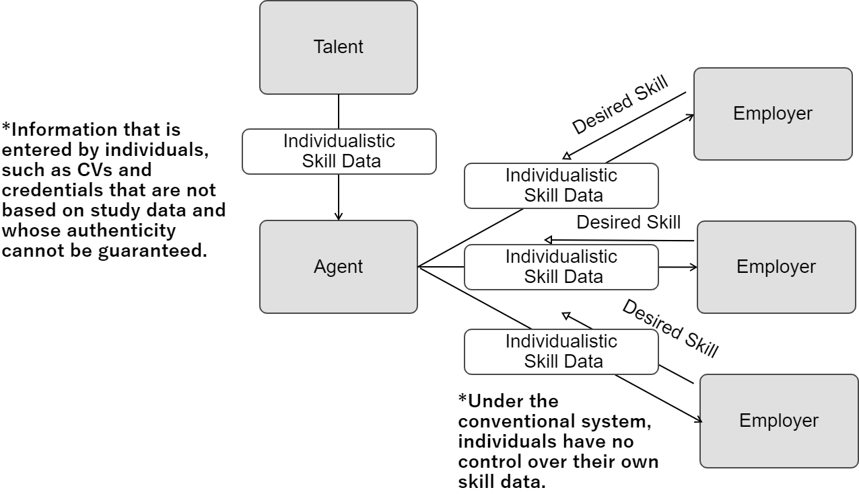
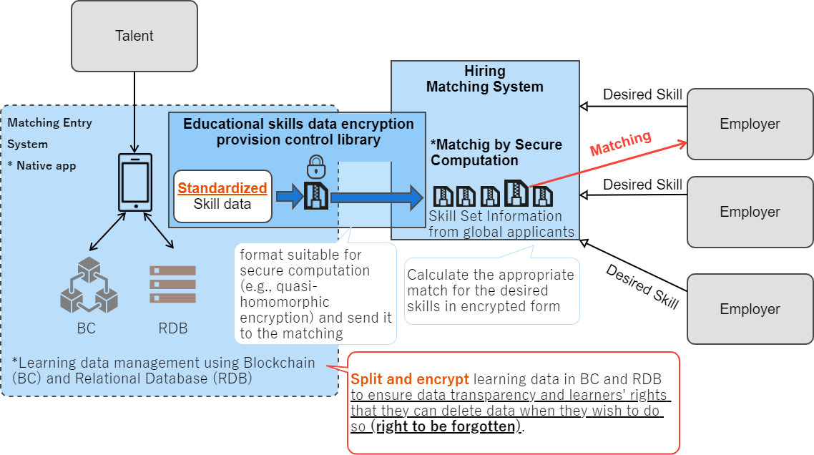
Building a trusted network to expand global education and labor market mobility across the globe (Institution for a Global Society Corporation) (1/2)
Current Issues (Pain Points)
What Trusted Web Will Solve
- Difficult to confirm that education is being provided in accordance with labor market requirements.
- Unclear security management of personal information is not transparent, and managing learning data in a centralized manner is difficult.
- Management of personal information is complicated, and data acquisition of foreign talent requires compliance with personal information protection regulations.
- As international matching of human resources progresses and each country defines different personal information protection regulations, it is difficult to ensure substantial compliance.
- Introduces a system that enables the sharing of personal competence data worldwide while keeping learning data confidential, so that education can be provided according to market needs.
- Establishes a system that allows candidates to take charge of their own data management.
- Establishes a system that enables matching of talent data in encrypted form to reduce unnecessary data management.
- Establishes a system to encrypt personal data for international data transfer while complying with national privacy regulations.
Business scheme diagram before issue resolution (As-Is)
Business scheme diagram of use cases to be created (To-Be)
Career changer
Career changer
Potential
employer
Potential
employer
Potential
employer
Potential
employer

Slide 2
Building a trusted network to expand global education and labor market mobility across the globe (Institution for a Global Society Corporation) (2/2)
Data to be Verified
Issues to be Verified | Object of Verification | Verification Method | Verifier
(1) Standardizing skill data from career changers | Skill data calculated from learning data of career changer based on ESCO standards | Probability feedback on standardized skill data based on ESCO standards | Employer
(2) Global personal data portability of career changers | Learning and demographic data of career changers | Confirmation of successful secure computation results and data encryption | Third party
(3) Managing learning data by individual career changers | Learning data for individual career changers | Confirmation of successful splitting and encrypting learing data in blockchain (BC) and relational databases (RDB) (design specifications only) | Career changers
Verification Points
(1) Prepare eight levels of skill data based on ESCO standards, which are increasingly being utilized internationally.
(2) Calculate the skill data for talent matched to companies by multiplying the weight of encrypted learning data from career changers against the weight of learning data from individual companies via secure computation.
(3) Store divided and encrypted learning date in BC and RDB to ensure its authenticity and the talent’s right of deleting it.
Business and Operational Validation (including UX/UI)
The following particular aspects were focused on in the PoC.
- What abilities should employers expect from job seekers?
- How should a smooth UX/UI be designed for recruiters, especially when hiring international talents?
- How should the matching of talents with employers be achieved while keeping their learning data confidential?
- How can talents control their own data such as disclosing and deleting their learning data without relying on the platform?
Main
Achievements
The main achievements from the PoC are as follows.
- Developed a secure architecture where only job seekers manage keys for their data, preventing unauthorized decryption.
- Employed lattice cryptography for encrypting learning data and company weights, ensuring quantum-resistant operations in Lattigo
with the CKKS scheme.
- Created a scatter plot for efficient matching, with talents' desired salaries and encrypted skill data calculated via secret computation.
- Designed a system for personal data management using distributed technology, allowing data encryption and storage split between
blockchain and databases.
- Received feedback from companies on courses for Vietnamese students and skill data, noting some gaps in information for hiring.

