Slide 1

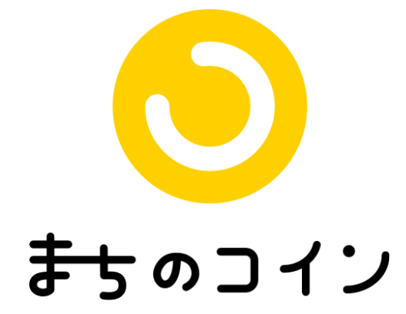
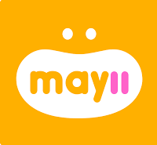


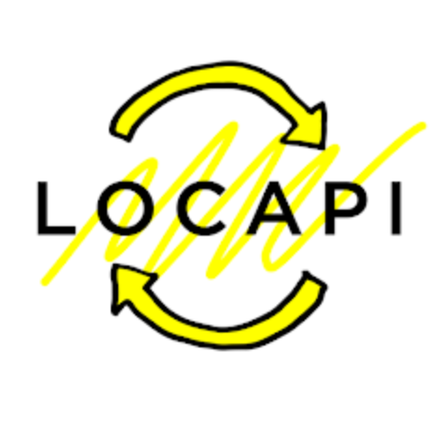


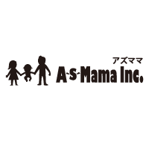

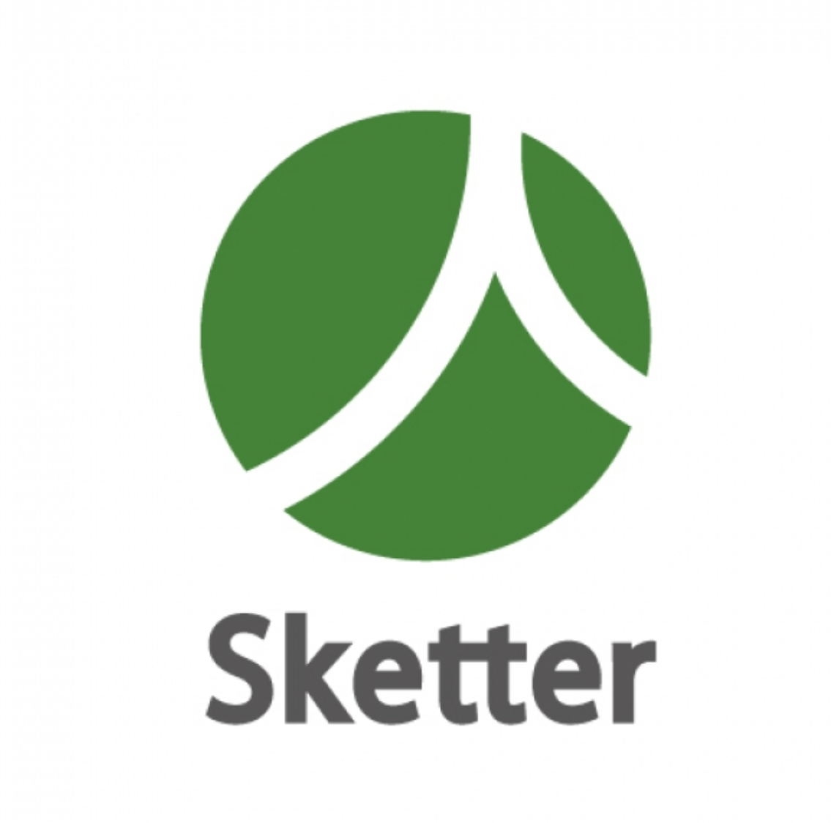
Trust formation ecosystem across mutual aid applications（Dai Nippon Printing Co., Ltd.）（1/2）
Current Issues (Pain Points)
What Trusted Web Will Solve
While trust verification is important for mutual aid applications to avoid problems, there are issues such as compatibility with privacy and increased hassle of registering user information.
Apps are offering supporter’s user profile and linking with SNS to enhance their trust. However, the system cannot prove the authenticity of such self-reporting data.
User rating can be used for trust verification. However, as some mutual help apps have small number of users, such app alone cannot provide sufficient rating data.
Users can manage their own data and provide it to the third party while protecting their privacy. Through this the scope of trust verification may be enhanced than ever.
Allows users to present their own data to third parties, potentially increasing the scope of trust validation without significantly increasing the need for privacy-conscious information entry.
By linking information across more than 300 sharing services, including mutual aid applications, mutual aid achievements from other applications can be accumulated and used for trust verification. In addition, by making the system capable of verifying mutual aid achievements in university entrance examinations and job searches, it will lead to stronger incentives for mutual aid app supporters.
Diagram before the issue solved（As-Is）
Diagram of the demonstration use case (To-Be）
Mutual help achievement data is not accumulated→Unable to verify trust within mutual help app→Users cannot use app with confidence→does not increase users. Such a vicious circle can lead to withdrawal from the business.
Building an ecosystem with centralized database that links relevant information from all mutual help apps is not feasible. We studied method for sharing the mutual help achievement data by using distributed ID system technology as Verifiable Credential（VC）
Trust verification activities
Mutual help app
Supporter
Mutual help app
User
Supporter
User
Presenting profile
Self-reporting information
Digital
Identity
Wallet
mutual help achievement
Mutual help app
Linking with SNS
User rating
Users cannot feel comfortable as trust verification is not sufficient
Enhanced trust verification
Data accumulation is difficult.
Share mutual help achievement among apps
Display other app’s
mutual help achievement

Slide 2
Trust formation ecosystem across mutual aid applications（Dai Nippon Printing Co., Ltd.）（2/2）
Data to be verified
To issue a digital certificate of the activity results in the Mutual Aid App and to improve the trust of the supporter, the authenticity of the results is verified by the signature verification of the VC. The VC of a supporter issued by Mutual Aid App A is verified by another Mutual Aid App B according to the use case.
【Use Case 1】 Trusted Profile
The scope of trust verification for online profiles can be expanded by linking digital certificates whose issuers are trusted.
【Use Case 2】 Incentives from beverage manufacturers
Easy coordination of mutual aid performance to third-party firms can increase incentive creation opportunities and stakeholders.
【Use Case 3】 Nursery School Application Use Case
The program will be used to add points to the adjustment index for preschool applications, thereby providing incentives for community activities and streamlining the online application process.
Legitimacy to be verified | Object of verification | Verification Method | Verifier
Sharing of Mutual Aid Achievements | Contents of Mutual Aid Achievements | VC signature verification | Mutual aid application B, third-party companies
Identity verification + alpha information | Achievements and course history on the mutual aid application | Signature verification of VC | Mutual aid application B, third-party company
Development of governance and community activities
A trust framework was developed that could be agreed upon among multiple stakeholders, with reference to prior accreditation systems.
Business validation (including UX/UI)
We discussed with the mutual aid application vendor how to display and link mutual aid achievements, including the creation of a demo screen for Wallet, which accumulates mutual aid achievements, and examined ways to promote the benefits through a more intuitive user experience.
Main
Achievements
Governance Formulation
The necessary items for the trust framework were organized and a document for the Mutual Aid Trust Framework was developed.
Discussions were held with experts based on the formulated document, and responsibility breakdown points for each stakeholder were organized.
Business validation (including UX/UI)
Examined customer experience use cases that would improve the trust scope by leveraging mutual aid achievements.
Created mockups of the examined use cases and conducted UI/UX research through user interviews.

