Slide 1
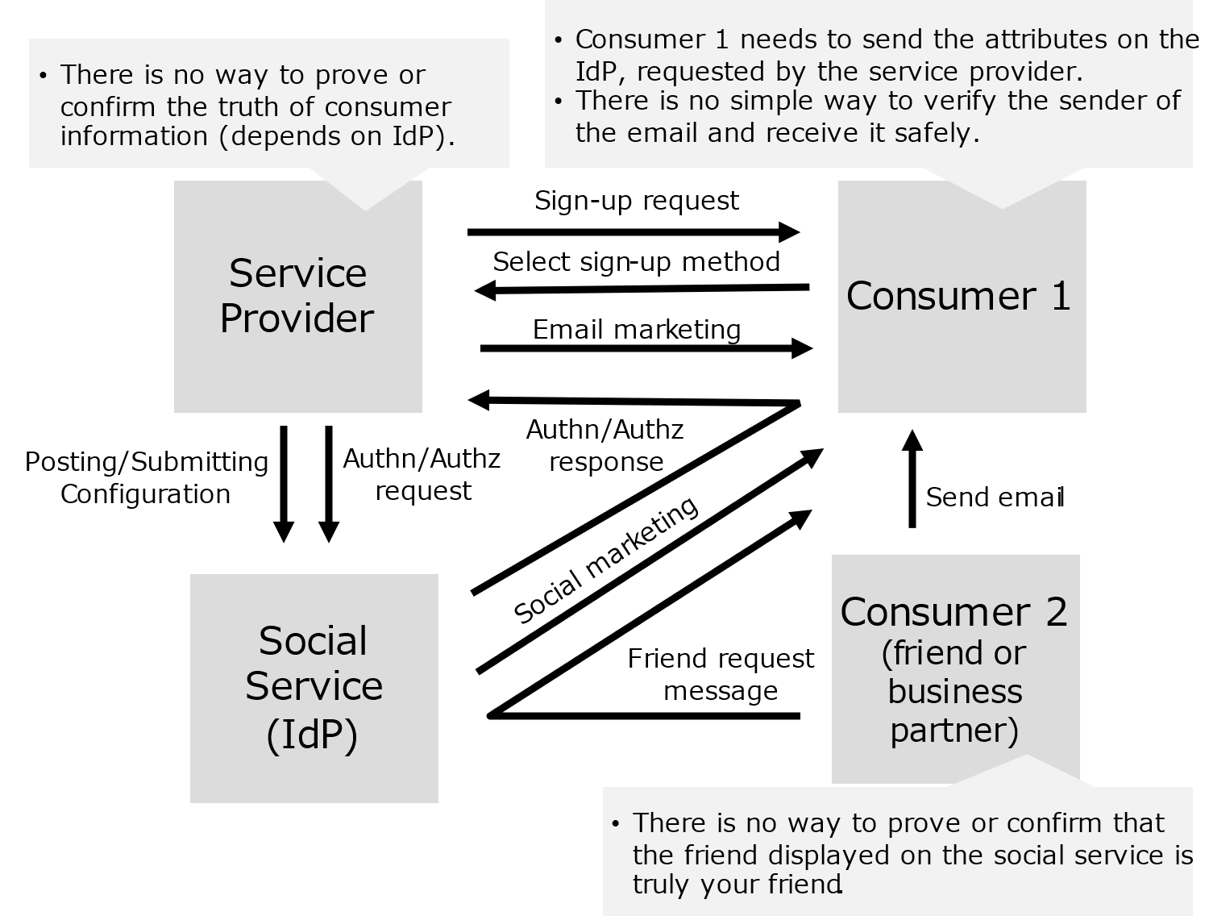
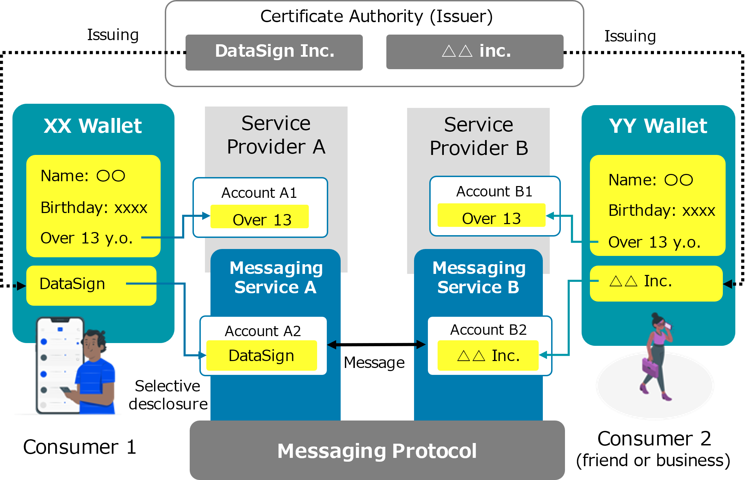
Wallet-based identity management and online communication (DataSign Inc. ) (1/2)
Current Issues (Pain Points)
What Trusted Web Will Solve
Consumer 1 finds it helpful to use the login function of the social service (IdP) but does not want to give attribute information managed by the IdP to unfamiliar service providers.
When consumer 1 tries to send a message using a specific social service, consumer 2 (friend or business partner) must also be using that specific social service to send the message. Email is not secure because the sender cannot be verified.
Service providers want to confirm and verify the attributes of consumers, but identity verification is high cost and inhibits consumers' UX.
Service providers want to provide consumers with an easy way to sign up for services, but supporting multiple social services would adversely impact the UX.
Consumer 1 can send the minimum attributes to service providers and consumer 2 at his/her own choice, without depending on specific provider.
Consumer 1 can verify attributes with consumer 2 or service provider mutually and can communicate securely online within the agreed scope, without depending on specific provider.
Consumer 2 can also do the same as the above two cases of consumers 1.
Service provider can easily verify and confirm the attributes and provide appropriate services without depending on specific provider.
As-Is
To-Be

Slide 2
Wallet-based identity management and online communication (DataSign Inc. ) (2/2)
Data to be verified
Legitimacy to be verified | Object of verification | Verification Method | Verifier
Identity verification of consumers | Existence of the identity | Verification of certificates complying with verifiable selective disclosure (SD-JWT) | Service provider (messaging service)
Attribute verification of consumers | Attribute of the identity (being 13 years or older) | Verification of certificates complying with verifiable selective disclosure (SD-JWT) | Service provider (messaging service)
Existence and legitimacy of Issuers | Authentication of organization | Authentication by third-party authority (OV certificate) | Consumer Service provider
Existence and legitimacy of of service providers | Authentication of organization | Authentication by third-party authority (OV certificate) | Consumer
Legitimacy of message sender | Attributes of sender (belonging to the org.) | Verification of certificates complying with verifiable selective disclosure (SD-JWT) | Consumer 1 (Recipient)
Legitimacy of message recipient | Attributes of recipient (belonging to the org.) | Verification of certificates complying with verifiable selective disclosure (SD-JWT) | Consumer 2 (Sender)
UI/UX
How to achieve user-friendly UI/UX in wallet and messaging service?
Privacy
What technologies should be selected for privacy by design?
Community
What kind of community should be created to spread the proposed architecture?
Governance
What governance and rules are essential?
Main
Achievements
UI/UX design and research for the wallet and messaging service were conducted under the supervision of the designers, and we verified that the UI/UX is user-friendly and released publicly available Figma UI component files.
We developed the wallet and messaging service using global standard technologies that are expected to be widely used in the future and selected the technologies to be used based on the advice of experts regarding selective disclosure, anonymity, and external dependence for privacy by design.
We established an open-source community called OWND Project (https://github.com/OWND-Project/) for continuing operation and promotion the developed wallet and messaging service.
We developed a governance model for the wallet and messaging service within the OWND Project community and published it as a white paper to enable governance of future products using the OWND Project open-source software.

