Slide 1
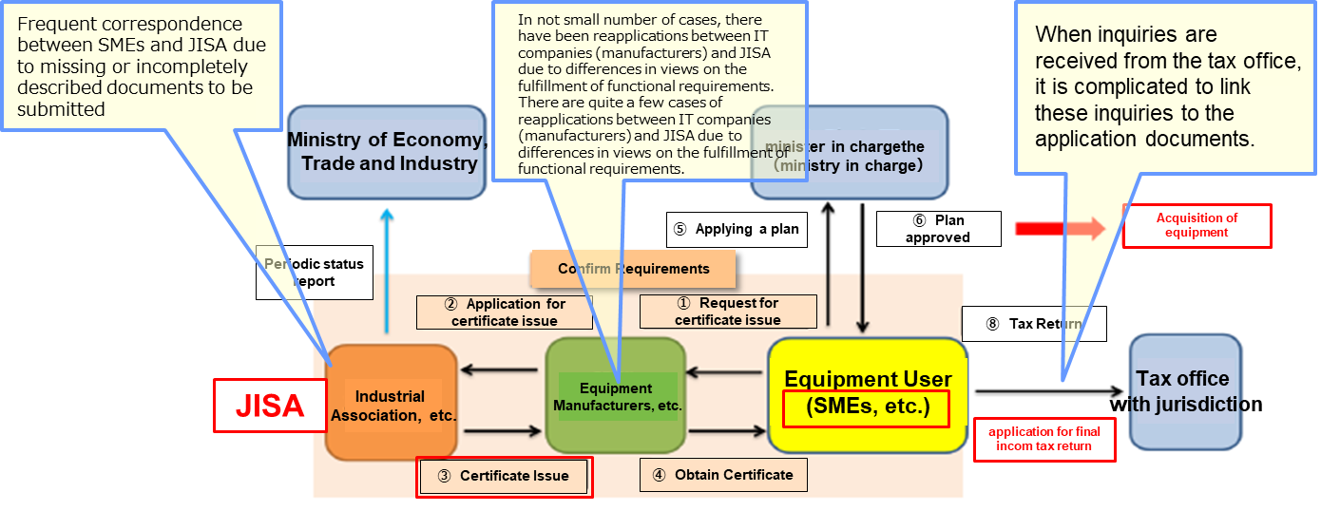
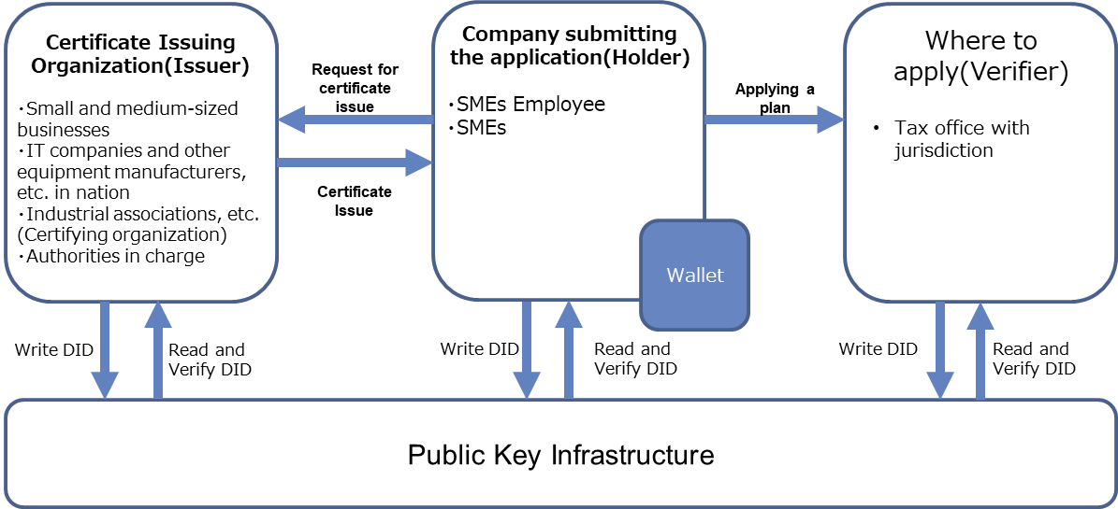
Corporate tax system and industrial association certificate (Japan Information Technology Services Industry Association)（1/4）
Current issues (Pain points)
What Trusted Web Solves
There are following issues when SMEs apply for industrial association certificate to seek reduced tax rate (Issuance of Industry Association certificate).
①Application work is complicated as the current procedure is based on papers.
SMEs and JISA need multiple inquiries due to incomplete application and documents etc.
Linking with the application document to the inquiries from tax office etc. is complicated.
②As application to Industry Association Certificate requires multiple documents, confirmation of the reliability such as the submit document (tamper-free) and correct content in multiple attachment are difficult.
Digitalize the procedure for work efficiency and improve the trust of submit document by using VC¹ as a digital certificate.
①Digitalization of application form and documents
SMEs can apply for Industry Association Certificate in the digitalized system by a browser-based Wallet application.
SMEs can use Wallet application to link and confirm of digital certificate (VC) and contents of the inquiry.
② VC enables to ensure the credibility of application data etc.
JISA can issue digital certificate (VC) to SMEs after confirming the application from SMEs meets the requirement.
SMEs can swiftly submit attribution data requested by tax office etc. by VC.
Tax office etc. can confirm the certification provided by VC (tamper-free).
Scheme diagram before problem solving（As-Is）
Scheme diagram of this demonstration use case (To-Be）
1）Verifiable Credential（VC）：self-sovereign digital certificate that can be verified online. W3C, international SDO, standardize this mechanism
where the Third party (verifier) can verify certification issued by Issuer to Holder. Japan adopted for vaccination certification.（https://www.w3.org/TR/vc-data-model/ ）

Slide 2
Corporate tax system and industrial association certificate (Japan Information Technology Services Industry Association)（2/4）
SMEs business management enhancement tax type A
Positive law
Related articles of Act on Special Measures Concerning Taxation
SMEs Business Enhancement Act
Certificate Requirement ：Ordinance for Enforcement
Ministry of Finance Service life table
・Machine ・Building equipment
・Tool ・Software
・Equipment
Industry Association Certificate
・ Japan Information Technology Services Industry Association (JISA) analyze software that we handle from SMEs business management enhancement tax type A. Project focuses on a feasibility study for the sample analysis, not for DX of Industry Association Certificate in general.
There are 2 types of software JISA handles: ①Issuance of certificate with pre-registration for package software etc. (requires pre-confirmation registration application for functional requirements in advance）②Issuance of certificate without pre-registration for individually developed software (confirm requirement for each application). Our target is ①.
Concept organizing phase
Development
Feasibility study on DX of Industry Association Certificate for sample analysis
View of Trusted Web world

Slide 3
Corporate tax system and industrial association certificate (Japan Information Technology Services Industry Association)（3/4）
Results of Business models
・As mentioned before, this project focuses on a feasibility study for the sample analysis, not for Industry Association Certificate in general. The results is limited on software we analyze as a target.
・ We studied the operation/data flow to solve the current issue. Utilization of VC enables effective mechanism that ensure the trust of contents in the application.
＜AS IS＞
・ Industry Association cannot know which SMEs are the users as their equipment manufacturers etc. mediate the application and deliver the issued certification to the SMEs. As a result, securing certain range of trust from a business perspective is supported by "trust" and "business operations and roles" for equipment manufacturers, etc.
There is a potential issue when investigation such as the cancellation of certificate and impact investigation are required, due to highly relying on operation of such manufacturers.
＜TO BE＞
Digitalization using VC enables to review the roles of SMEs, equipment manufacturers (software providers) and Industry Association, and contribute to reduce burden of equipment manufacturers (software providers) .
Equipment manufacturers (software providers) | ・Proof applicants/target software meets the requirement of enhanced productivity. ・Know the (in this project, software) user and mediate the application and deliver the issued certification to them.
SMEs | Target equipment (in this project, software) users
Equipment manufacturers (software providers) | Provide a proof that the target software meets the requirement of enhanced productivity.
SMEs | Applicants/target equipment (in this project, software) users

Slide 4
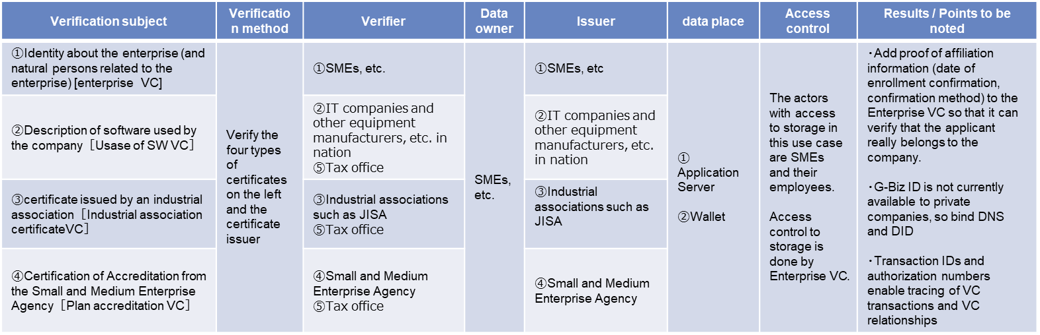
Corporate tax system and industrial association certificate (Japan Information Technology Services Industry Association)（4/4）
Data to be verified
Consensus building and
trace
Subject of agreement | ・SMEs and employees of SME ・SMEs and IT companies and other equipment manufacturers, etc. in nation ・SMEs and Industrial association such as JISA(Certifying organization) ・SMEs and authorities in charge(jurisdiction about the SMEs) ・SMEs and tax office in charge
Object of agreement | In this Usecase, there is a process of "presentation" and "acceptance" of documents and information necessary for application in the scenario, and the completion of the process of "presentation" and "acceptance" respectively is considered as an agreement.
Terms of agreement | That the agreed-upon attributes and credentials have been passed on.
Object of trace | That the above agreement has been fulfilled.
Subject of trace | Corporations and employees
Tracing method | Keep records of VC issuance and presentation in the Wallet used by the corporation and its employees, so that they can view them.
Whether and how to revoke the agreement | When a VC is revoked The Issuer can revoke the issued VC. After revoking the VC, the Holder cannot apply for issuance of a new certificate or present a new certificate with the VC due to the verification by the Issuer and Verifier. ・ If a VC has already applied for or presented a certificate, the agreement will be revoked upon re-verification by the Verifier who recognizes the revoke has occurred. (It is assumed that continued consideration is required for batch processing for multiple VCs that have already been applied or presented.) When the agreement is canceled ・ If the Holder side cancels the agreement when confirming the agreement of issuing or presenting VC, the acquisition or presentation process of the VC will not be performed. ・ If the Issuer or Verifier side cancels the agreement (e.g., expiration of the presented VC), the Holder is notified that the VC acquisition/presentation process has failed.
Achievements
Through this demonstration, we can verify the improved convenience in the digital application and feasibility of securing credibility by VC in the application to JISA Industry certification.

