Slide 1
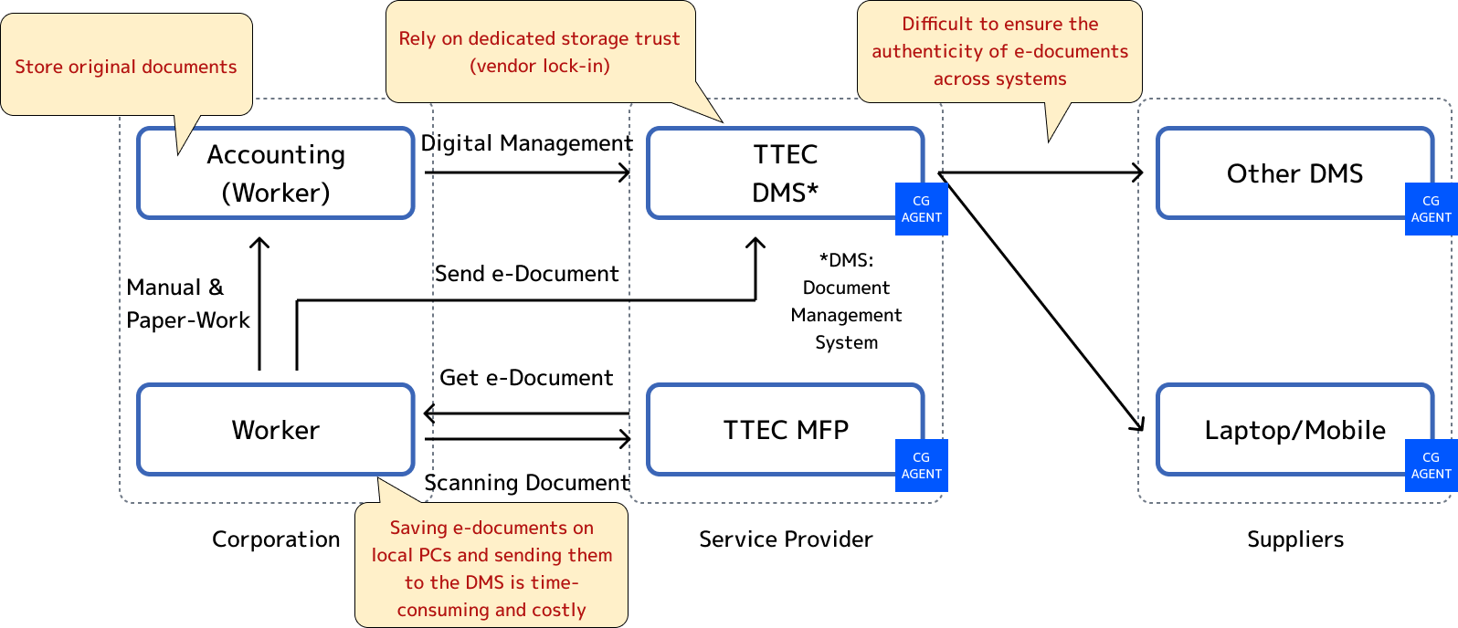
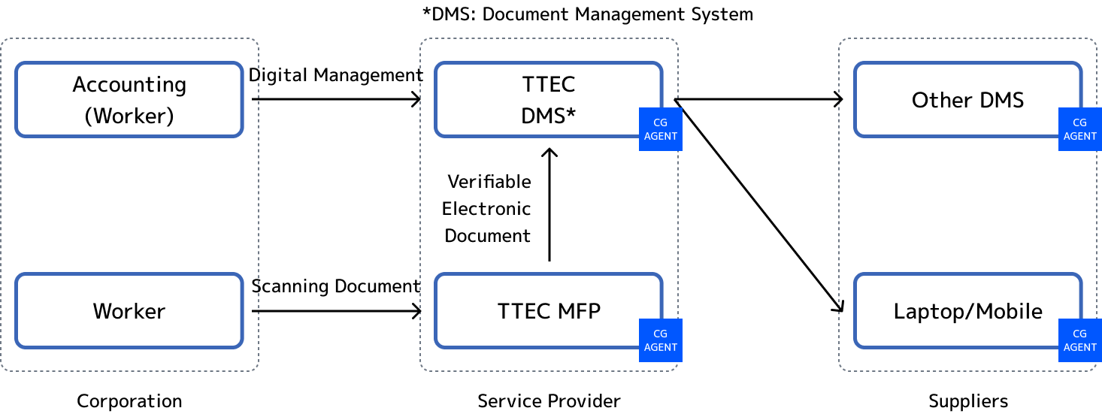
Trustable digitalized document distribution system for workplace (TTEC¹ and CG²) (1/2)
Current issues (Pain points)
What Trusted Web Solves
The risk of tampering with documents (financial document, administrative document etc. ) that require an audit trail (data on creation device, author, date of creation and revision history of the digital document) can make it challenging to scan and manage them digitally using Multifunction Peripheral (MFPs).
In certain industries and operations, paperwork is not being digitized, which forces workers to continue performing unproductive tasks.
Building the infrastructure necessary to distribute digital documents with audit trails from MFPs to the cloud imposes high costs on service providers.
By utilizing DID and VC standards³ by W3C, an international SDO, documents can be digitized and distributed with an audit trail that originates from MFPs.
Paper work in specific industries and operations can be digitized, increasing worker productivity and reducing back-office costs as well as improving work styles.
CG's data infrastructure solutions can be used to establish verifiable electronic document exchange between MFP devices and the cloud at a low cost.
Scheme diagram before problem solving （As-Is）
Scheme diagram of this demonstration use case （To-Be）
3rd party SaaS
3rd party SaaS
1）Toshiba Tec Corporation. Representative organization in charge of overall control of the project, promotion and operation management of the project, and development of the MFP.
2) CollaboGate Japan Inc. Uses its own data infrastructure solutions to verifiy communication & data, and realizes audit trail.
3）Decentralized Identifiers（DID）、Verifiable Credentials（VC）。Distributed identifier and verifiable certification standardized by W3C（https://www.w3.org/TR/did-core/ ）（https://www.w3.org/TR/vc-data-model/ ）

Slide 2
Trustable digitalized document distribution system for workplace (TTEC¹ and CG²) (2/2)
Data to be verified
Digital documents to verify when, by whom, and from which MFP device they were generated.
MFP identifier (DID), user name, and serial number are used as meta data.
MFP generates a verifiable credential and sends it to the document management system as a DIDComm Encrypted Message.
Issues Requiring Verification | Subject to Verification | Verification Method | Verifier
Audit trial of digital documents | Authentication of Digital documents | Verify the VC signature | The document management system
Consensus building and trace
The end-user that owns or uses the MFP agree on the term of service with the service provider. The end-user can check whether the agreed-upon conditions are being fulfilled by requesting the service provider to check the traffic log. The traffic logs are stored in the CG‘s HUB(a relay server relays encrypted data among agents by CollaboGate Inc.), and it is possible to check when and from which device (identifier) data was sent to which destination.
Achievements
Confirmation that anyone can easily digitalize the documents that requires an audit trail without changing the existing MFP’s user experience.
Confirmation that the trusted data infrastructure to achieve the above can be built at a low cost.(compared to the establishing the data infrastructure from scratch, decrease the cost by about 300 million yen (based on our calculation))
Confirmation of the possibility of deploying a similar infrastructure to a wide variety of devices (POS system handles payment information, network camera handles flow of people, medical device handles vital data etc.)

