Slide 1
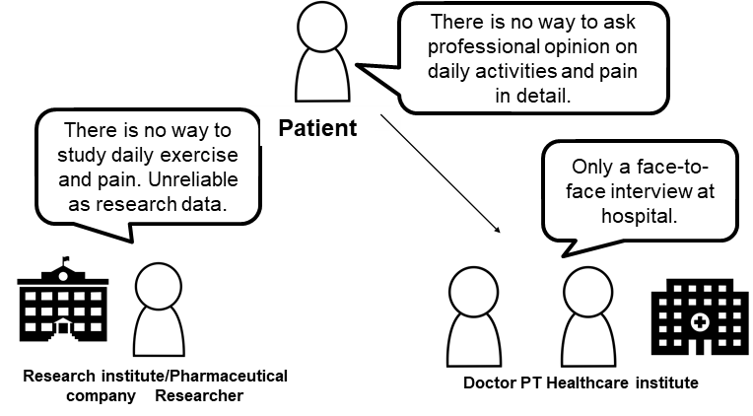
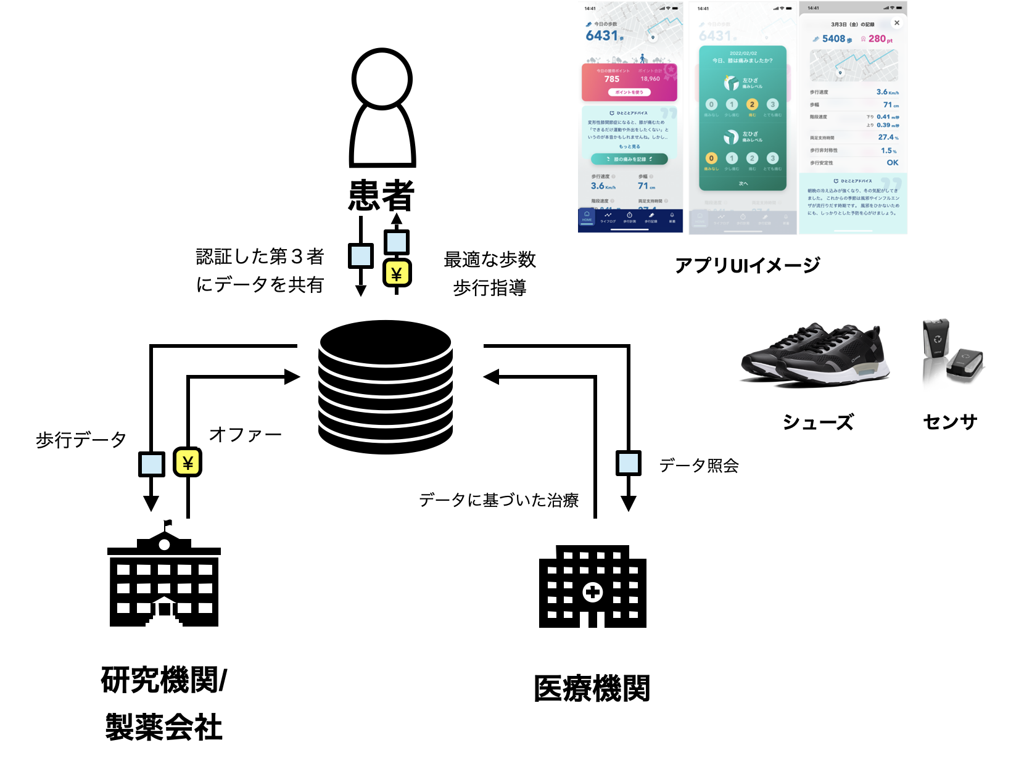
Trusted walking data distribution system among lower limb musculoskeletal diseases patients, doctors and researchers (ORPHE Inc.)（1/2）
Current issues (Pain points)
Matters to be solved by the realization of TrustedWeb
Lower limb musculoskeletal diseases patients want professional opinion by sharing their daily walking and pain data. However, the only way to do so is visiting a hospital. Treatment optimization method based on daily data has not established.
Doctors and physical therapists (PT) want to optimize treatment by using patient’s daily data. However, the only way to do so is a face-to-face interview at hospital and not efficient.
Researchers and pharmaceutical companies want to use patient’s daily walking and pain data. However, they do not have access to such data, and there is a risk of data tampering and data entry error and hinder their utilization.
Enables to share the patient’s data by providing gait and pain data with professionals in VC by W3C VC¹ standard. Professionals can confirm the patients data by VC signature and share daily data online that lead to efficient care.
Wallet application enables Doctors and PT to access the data to the appropriate extent of the scope.
Wallet enables researchers and pharmaceutical companies to request appropriate patients to sharing data while protecting privacy of personal data. Distributed storage lowers the risk of tampering when exchanging such data.
Scheme diagram before problem solving (As-Is)
Scheme diagram of this demonstration use case (To-Be)
the accumulation and sharing of daily data
Patient
Share data with authenticated third parties
Guidance on optimal steps and gait
Application UI image
walking
data
data
request
shoes
sensor
research using daily exercise and pain data
data-based treatment
data authentication
treatment based on daily movement and pain data
Research Institute/
pharmaceutical company
Healthcare Institute
1) Verifiable Credentials（VC）.self-sovereign digital certificate that can be verified online. W3C, international SDO, standardize this mechanism where the Third party (verifier) can verify certification issued by Issuer to Holder. Japan adopted for vaccination certification.

Slide 2
Trusted walking data distribution system among lower limb musculoskeletal diseases patients, doctors and researchers (ORPHE Inc.)（2/2）
Data to be verified
Patients verify relationship-VC signature issued by data sharing requesters (doctors, research institutes etc.) to confirm user attribute who submits that request.
To confirm the accumulated biometric data belongs to the patient, verify identification or sensor data while recording the data (in the future).
Record hash on a distributed storage (Private Data lake IPFS) to verify the patients input data such as walking measurement and subjective pain etc. have not been tampered.
Legitimacy to be verified | Object of verification | Verification method | Verifier
User attribute | Verify access user’s affiliation | Verification of VC signature | Patients, medical professionals, researchers
Being the data belongs to the patient | User input data on walking measurement and subjective pain etc. | Identity verification at the time of recording（in the future, gait recognition based on sensor data） | Medical professionals, researchers
Non tampering of patient’s data | User input data on walking measurement and subjective pain etc. | Record hash on a distributed storage (Private Data lake IPFS) | Medical professionals, researchers
Consensus building /
Trace
Data providers and data viewers agree to share the data in specified period. To do so, the data provider endorse the request issued from the web management screen on the application. The executed agreement is traceable by checking the VC usage log. Canceling the agreement and the data withdrawal are also possible.
Achievements
We confirmed the feasibility and demand of the system through the implementation of application and trial demonstration with some lower limb musculoskeletal diseases patients.
Successful implementations of verification of user attribution and non-tampering of patient’s data.
This project relies on data from shoe-sensors. On verification of the data source whether the patient is the user at the time of recording, it needs further study for implementation. To do so, we recognized the need of additional analysis techniques such as gait recognition of sensor data.

