Slide 1
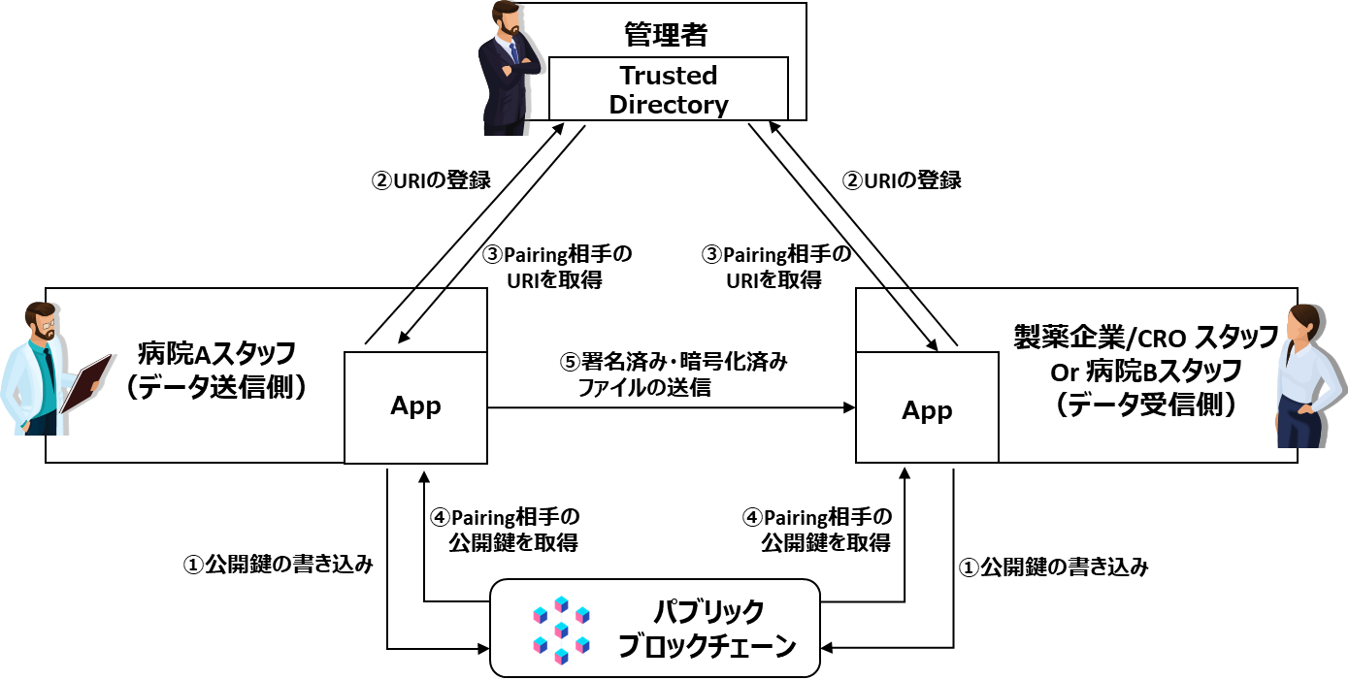
Information distribution system with high reliability and applicability in clinical trials and medical sites
Consortium for the Development of Healthcare Information Distribution System)（1/2）
Current issues (Pain points)
What Trusted Web Solves
In the clinical trial and healthcare industry, critical information and processes are still tend to be recorded on the paper. This increases operational cost. There is also a cost for pharmaceutical company that sends its personnel to the site to check paper data of clinical trials. These increase the social security cost in the form of drug development costs and prices. Strictly speaking, the parties on-site cannot ensure the identity and information of concerned parties who exchanges the information have not been tampered with.
Even where digital systems are in place, the following issues have emerged.
High cost for licensing, building and operation for the system as well as a need of the specialists (e.g. EDC: Electronic Data Capture)
There is a risk of impersonation uses other person’s account information and insufficient ID management and traceability
Implement Keychain Core¹‘s Blockchain framework and DID² linked with the device of the concerned parties to build system that transfers the encrypted files exclusively among parties carried out Pairing³. This system ensures information trust and improved convenience.
Reduce management and operational costs of paper media by digitalized systems.
Easy implementation by building a versatile system that encrypts and exchanges several files (data) in forms only seen by trusted users.
Reduce impersonation risk by implementing DID linked to device of the concerned parties and ensure the safety and avoid tampering by system that exchanges encrypted files exclusively among parties carried out Pairing.
The design of this system uses DID and allows users to control information proactively and a dynamic management of trusted users. These can be a platform to realize appropriate information exchanges among hospitals, between patients and their hospital.
Scheme diagram before problem solving （As-Is）
Scheme diagram of this demonstration use case （To-Be）
High cost due to the need for partially optimized systems
Risk of identity theft by knowingly allowing others to use the ID/Password
Administrator
②Register DID
②Register DID
Hospital A Staff
(Data sender)
System
Pharmaceutical Company/CRO
Staff
or
Hospital B staff
(Data receiver)
③Obtaining the DID of the Pairing partner
③Obtaining the DID of the Pairing partner
Hospital A Staff
(Data sender)
⑤Sending signed and encrypted files
Pharmaceutical Company/CRO
Staff
Or
Hospital B staff
(data receiver)
Paper
High operating and management costs
On-site monitoring is required
Identity and non-falsification cannot be strictly guaranteed
④Obtain the Pairing Partner's Public Key
④Obtain the Pairing Partner's Public Key
①Writing public key
①Writing public key
Public Blockchain
Solution package for data/ID management that enable implementation of DID etc. based on blockchain by Keychain Pte. Ltd.
Decentralized Identifier（DID）：Decentralized Identifier standardized by W3C, international SDO（https://www.w3.org/TR/did-core/ ）
3) This Use Case aims to confirm other party’s trust by DID and to establish interconnection for data exchanges.

Slide 2
Information distribution system with high reliability and applicability in clinical trials and medical sites
Consortium for the Development of Healthcare Information Distribution System)（2/2）
Data to be verified
The sending party signs and encrypts the sending data (includes clinical test data) to secure the data has not been tampered with.
The received encrypted data can be verified by confirming that the sending party’s DID that performed the Pairing has encrypted the data.
Legitimacy to be verified | Object of verification | Verification Method | Verifier
No tampering with transmitted data (contents of files containing clinical trial data) | Signed and encrypted files | Verification of the signatures and decryption are available | Pharmaceutical Company/CRO Staff
No impersonation | Signed and encrypted files | Signed and encrypted with the same DID as the Paired DID | Pharmaceutical Company/CRO Staff
Consensus building and tracing
The data sender (hospital staff) and the receiver (pharmaceutical company/CRO staff) agree to “be able to trust each other”, and “transfer of the data”. Assume that the agreement is formed by the data sender and receiver verifying the signature and encryption/decryption and carrying out signature verification after confirming the DID list file (the list of trusted parties) that can decrypt. The executed agreement can be traced by checking the history of encryption and decryption (audit trail).
Achievements
During the demonstration period, we conducted a field test of the prototype system between the actual medical institution network and our network with Souseikai Global Clinical Research Center (Souseikai). In addition, we conducted interviews with internal and external experts and stakeholders. The results, suggestions, and comments obtained from these field tests and interviews are as follows.
(Results) The field test was completed without any problems, and the expected behavior and effects were confirmed.
(Comments/Implications) Souseikai's reaction was that they would like to introduce the system to clinical studies and epidemiological studies conducted by medical institutions and academia, which require low-cost planning and implementation and currently do not guarantee data integrity. The possibility of implementing a low-cost model for trials and studies that require a large amount of money for implementation was suggested by simplifying the content of work within the process without making major changes to the existing process itself.
(Comment) We feel that the architecture of the prototype system and the benefits obtained from it will be an example of what the future should look like. On the other hand, we feel that it is over-engineered compared to the concept of data integrity currently required in the medical field and the clinical trial. Therefore, we feel that activities to disseminate the architecture of this prototype system, and the technical requirements required in the Trusted Web white paper to society as a whole are necessary.

