Slide 1
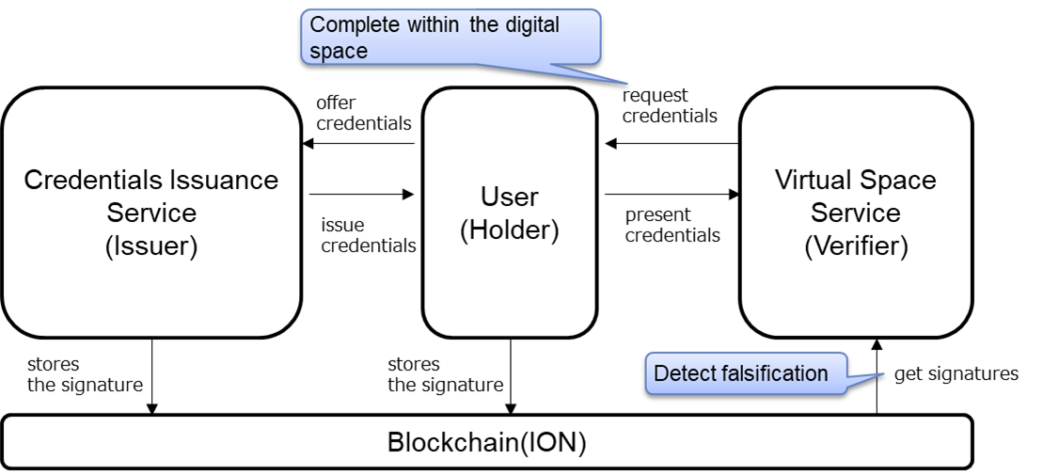
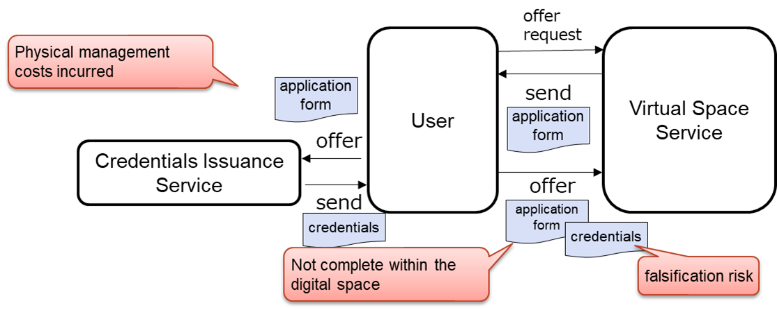
Trust verification of service eligibility and provided data in virtual reality space（1/2）
Current issues (Pain points)
What Trusted Web Solves
Virtual space services such as Metaverse are getting popular. However, they do not have verification method for user (avatar)s credentials in the sales agreement etc. among service provider and the users.
＜Users＞
・It is difficult to prove user's identity (student ID etc.) on a virtual space service while maintaining a sense of immersion.
＜Service provider＞
・It is difficult to verify user's identity on a virtual space service while maintaining user’s sense of immersion.
DID¹/VC² and Wallet application enable to complete following submission and verification of credentials.
Users can submit credentials issued by credential issuance services by DID/VC and Wallet in the virtual space service.
Service providers can receive credentials in the virtual space and verify the credentials (detect the falsification) by checking the signature written on the blockchain.
Scheme diagram before problem solving （As-Is）
Scheme diagram of this demonstration use case （To-Be）
application
request
・Request to complete application
credential
request
(Person)
(State, companies etc. )
(Issuer)
(Person)
(Holder)
・completed
application
・present credentials
(State, companies etc. )
(verification)
1) Decentralized Identifier（DID）：Decentralized Identifier standardized by W3C, international SDO（https://www.w3.org/TR/did-core/ ）
2) Verifiable Credential（VC）：self-sovereign digital certificate that can be verified online. W3C, international SDO, standardize this mechanism where the Third party (verifier) can verify certification issued by Issuer to Holder. Japan adopted for vaccination certification.（https://www.w3.org/TR/vc-data-model/ ）

Slide 2
Trust verification of service eligibility and provided data in virtual reality space（2/2）
Data to be verified
Services provided on a virtual space need a user’s identification to check one’s eligibility based on laws such as Act on Prevention of Transfer of Criminal Proceeds.
In order to perform identity verification correctly, the authenticity of the credentials is required. Specifically, Information from Issuer (credential issuer) should be made into a VC, then the user submit it to the service provider on a virtual space, and the service provider verify the VC’s authenticity in the virtual space.
Legitimacy to be verified | Object of verification | Verification method | Verifier
Usage of service using fake credentials, impersonation | Authenticity of user’s credentials | Verification of VC signature | Virtual space service provider
Consensus building and tracing
User (user in the virtual space) and Issuer (Trust information issue organization), and user and Verifier (Virtual space service provider) make agreement on contents of each data contents received.
Make each agreement between user and Issuer, and between User and Verifier. These statuses are traced by displaying and checking the contents of the agreement of received data in the Wallet.
Achievements
We studied privacy protection issue specific to Metaverse. We learned it requires means to satisfy both verification of users credentials and their protection of privacy in Metaverse.
We studied monetize issue to spread the idea of Trusted Web. The result is following 2 items.
  We need a monetizing model for Issuer who is the service provider to issue Trust information.
  Even if the issuer passes the temporary information usage fee to the verifier, without a system to ensure data traceability for the issued Trust information, Issuer does not generate revenue for issuing Trust for that information at a certain cost.

