Slide 1
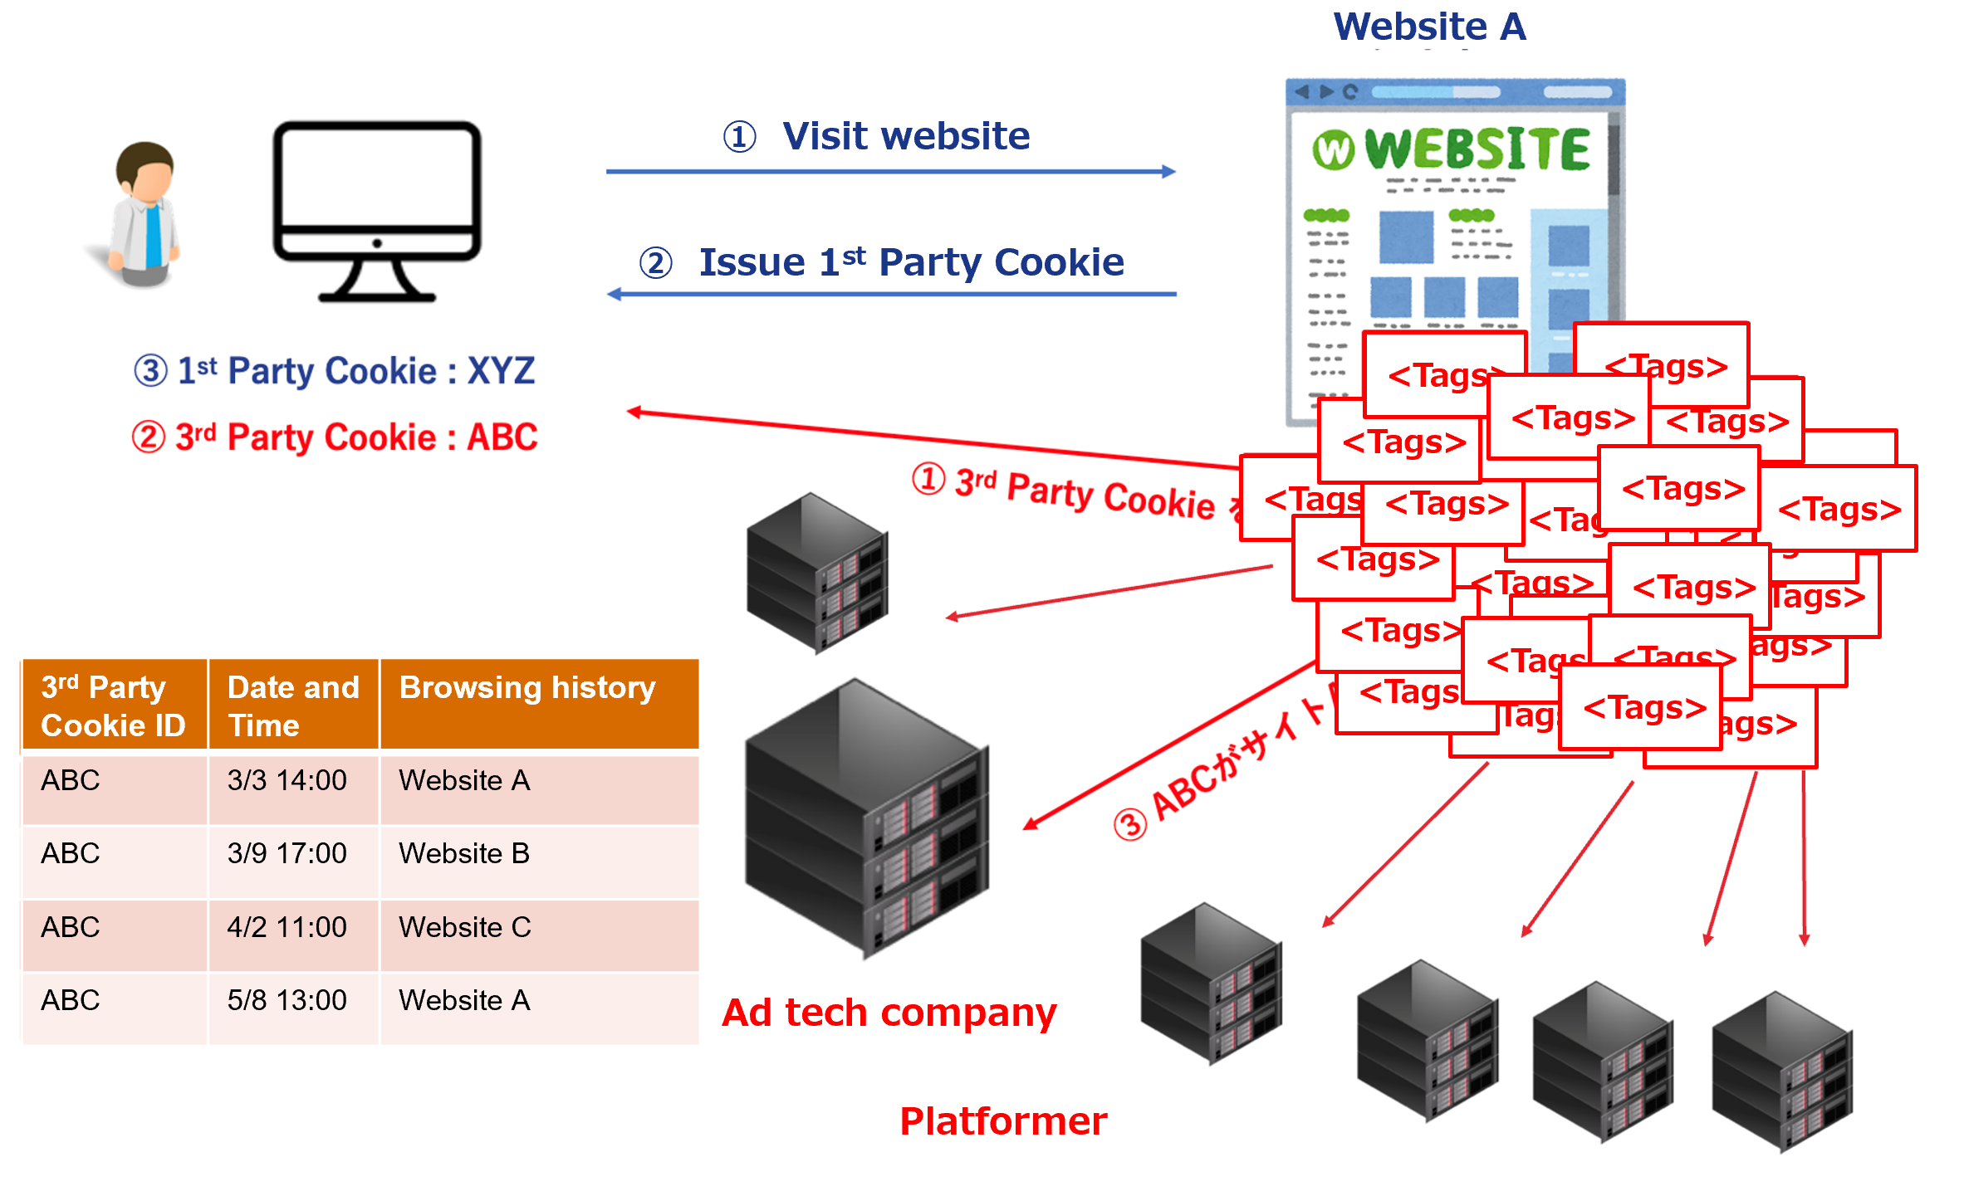
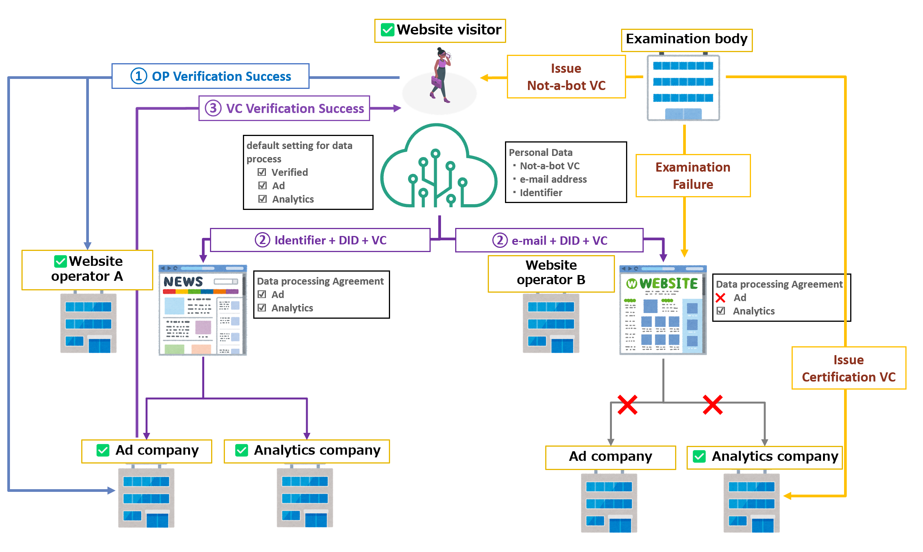
Personal data distribution in the online marketing（DataSign Inc.）（1/2）
Current issues (Pain points)
What Trusted Web Solves
In the online marketing that advertises to website visitors, website visitor (user)’ s personal data is collected by multiple entities without owner’s knowing. On the other hand, online marketers (website operators and ad tech operators) are not certain the credibility of the collected information.
Consumer’s personal data is acquired and used by third parties without owner’s knowing.
Website operators cannot control its website visitor’s information properly due to the theft caused by third parties.
Ad tech operators suffer from ad fraud due to the presence of bot¹ that fakes advertising effect.
Establish a mechanism where consumers can control their own personal data (data usage agreement and confirmation of that execution) and verify the legitimacy of the entities that use such data as well as the data credibility.
Consumers manage their own identifier used in online marketing and its destinations.
Each party verify each other based on the certification issued from the legitimate third party.
If legitimacy and verification check failures, agreement between the parties will be made on a case-by-case basis.
Scheme diagram before problem solving（As-Is）
Scheme diagram of this demonstration use case (To-Be）
1）Software and systems that imitate human operations and work. In this use case, the thing pretends website visitors (human) and falsely increase numbers of site and advertisement view.

Slide 2
Personal data distribution in the online marketing（DataSign Inc.）（2/2）
To resolve improper acquisition of personal data issue, pass the data promptly when the legitimacy of the party verified.
Regarding the ad fraud measure, website operators and ad tech operators request their website visitors to provide a non-bot certification to verify the access.
Data to be verified
Legitimacy to be verified | Object of verification | Verification Method | Verifier
Improper acquisition of website visitor’s data | Website operators and ad tech operators | Verify OP¹ for Website operators and ad tech operators issued by certification authority | Website visitors
Ad fraud caused by bots | Website visitors | Verify non-bot VC² issued by non-bot certification authority | Website operators and ad tech operators
Consensus building and
trace
Regarding the scope of personal data usage, we develop function based on the pre-agreed conditions to provide data exclusively to the verified parties swiftly. The party’s such acquisition and usage will be traced, and if required, disable them by withdrawal of the agreement.
Achievements
Demonstrate the usage of DID³/VC/DWN⁴/OP can solve the current issues on personal data distribution in the online marketing through building actual systems.
Verified the organization using Originator Profile (OP) and studied the universal function. We contribute to the future use cases of OP by providing feedback on the lack point of OP.
The development was difficult due the function and rules are not necessarily sufficient level as most of the DID, VC and DWN libraries are under development. We found the current missing part and challenges of the open source code after implementing concrete code based on the standardized specification and realized functions. Based on the finding, we provide the completed code and contribute to the open source development community.
1）Originator Profile（OP）：Technology identifies the content verified by the third party by providing authentication information of web content creators and advertisers in a verifiable form（https://originator-profile.org/ja-JP/structure/）
2）Verifiable Credential（VC）：self-sovereign digital certificate that can be verified online. W3C, international SDO, standardize this mechanism where the Third party (verifier) can verify certification issued by Issuer to Holder.
Japan adopted for vaccination certification.（https://www.w3.org/TR/vc-data-model/ ）
3）Decentralized Identifier（DID）：Decentralized Identifier standardized by W3C, international SDO（https://www.w3.org/TR/did-core/ ）
4）Decentralized Web Node（DWN）：Technology standard on data store that does not depend on a specific administrator by DIF, international SDO（https://identity.foundation/decentralized-web-node/spec/）

